Slide 1

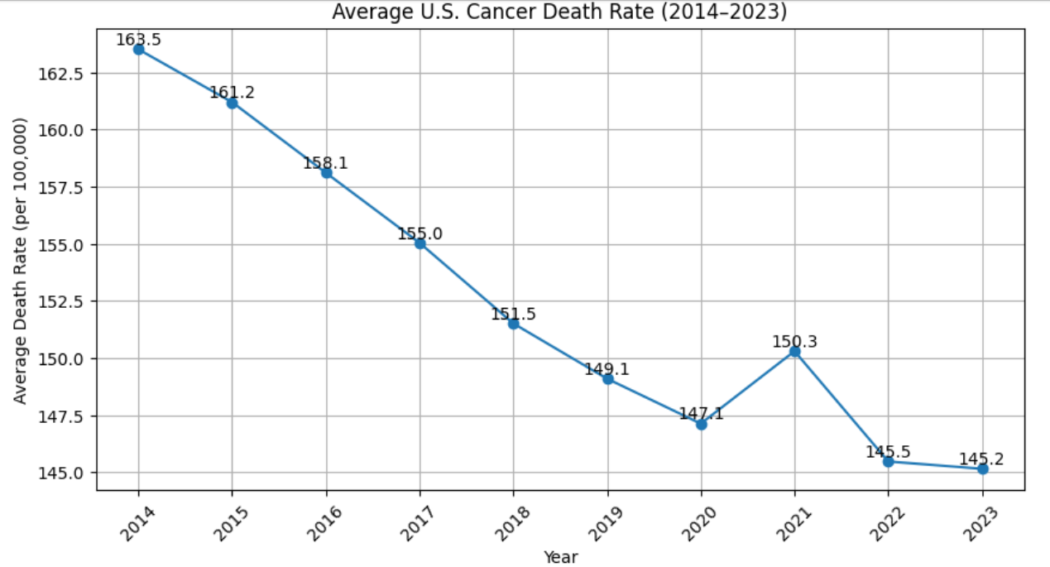
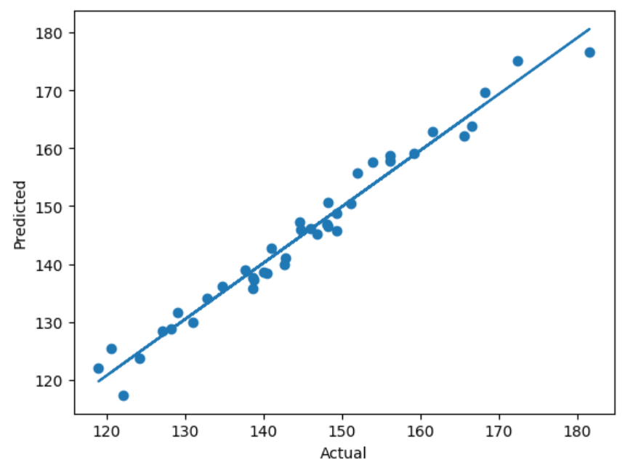
United States of America Cancer Death Rate Trends From 2014-2023
Cael Meacham
Introduction
This project explores trends in U.S. cancer death rates from 2014 to 2023 to determine how predictable these rates are over time. Using state-level data, multiple machine learning models were applied to analyze patterns, identify outliers, and predict 2023 cancer mortality rates based on historical values. While total cancer deaths may increase due to population growth, death rates provide a more consistent measure of risk and reveal a steady national decline. By combining regression, classification, clustering, and dimensionality reduction techniques, this project demonstrates that cancer mortality trends are highly stable and can be used to make accurate and meaningful predictions about future outcomes
The results of this project show that U.S. cancer death rates follow a consistent and predictable downward trend over time, making them highly suitable for machine learning prediction. Models achieved strong performance, with an R² of approximately 0.88 and low prediction error, demonstrating that historical data is an effective indicator of future outcomes. While total cancer deaths may increase due to population growth, the steady decline in death rates highlights improvements in overall health outcomes. Clustering and PCA further revealed that most variation in the data is driven by a small number of key factors, while outlier detection identified states that may require targeted healthcare strategies. Overall, this project confirms that cancer mortality trends are stable, interpretable, and valuable for guiding future analysis and decision-making.
Methods
This project applied a range of machine learning techniques to analyze and predict cancer death rates. Regression models, including Linear Regression, Decision Trees, Support Vector Regression, Random Forest, and Neural Networks, were used to predict 2023 rates from historical data. Classification was performed using a Support Vector Machine to group states into risk categories. Additionally, K-Means clustering was used to identify patterns among states, while Principal Component Analysis (PCA) reduced the data to its most important features. Outliers were detected using Z-scores to highlight unusual trends in specific states.
GitHub Repository
Resources
https://github.com/Cmeacham27/Machine-Learning-Final
https://www.cdc.gov/nchs/state-stats/deaths/cancer.html

